Slide 1
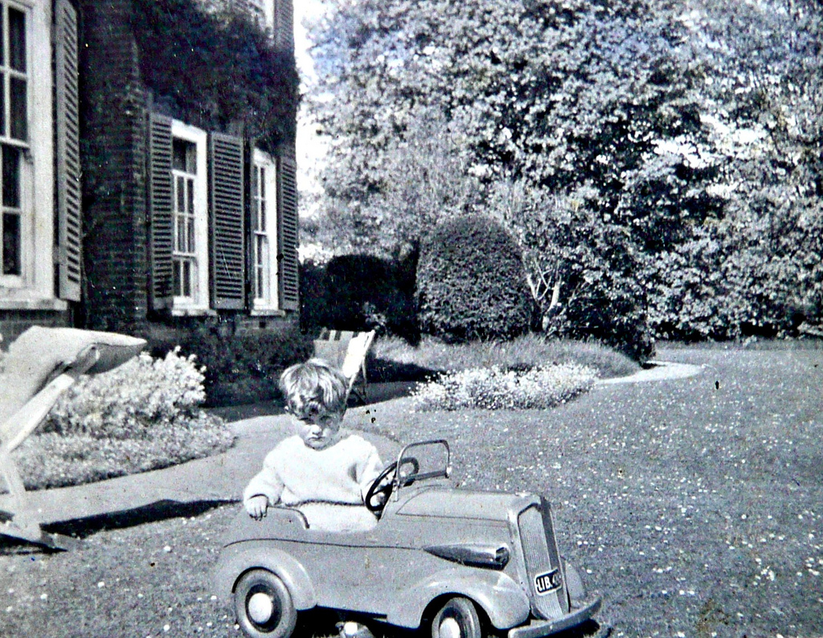
Courtney Greene Bret Davidson Handheld Librarian VI | 2.1.12
Under the Hood: Our UX-Driven Mobile Site Redesign
HerryLawford

Slide 2
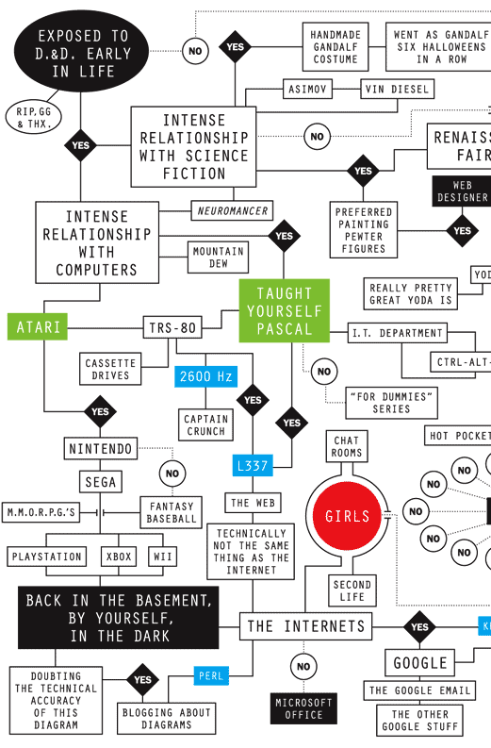
before we go any further….
what kind of geek are you?
respond in the polls
new york times (2008)
Notes:
Poll #1 (select as many as apply)
What is your role at your library?
Administration
IT/systems
Public services (reference, instruction, etc)
Technical services (cataloging, metadata, acq, etc)
LIS student
Poll #2
What kind of geek are you? [choose one]
* uber-geek (expert coder, professional programmer)
* pretty darn geeky (proficient coder)
* padawan learner geek (on a scale of familiar with code to dabbler in code)
* prefer nerd to geek, thank you very much (not familiar with code/no programming experience at all)

Slide 3
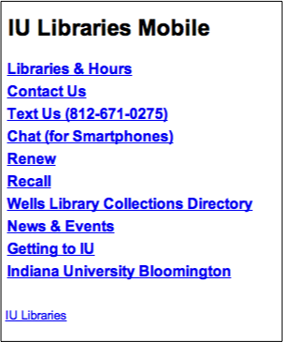
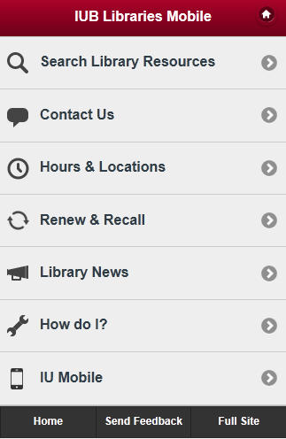
2009
Problem: Initial mobile site launched as test. Minimal staffing. Full participation in campus sponsored app impossible. User experience nil.
2011
Solution: Modify existing site - minimal work for maximum impact.

Slide 4
2009
Problem: Initial mobile site launched as test. Minimal staffing. Full participation in campus sponsored app impossible. User experience nil.
Focus: Improve existing information architecture, aesthetic
Cross platform solution
Increase traffic to mobile site
Leverage new technologies: HTML5, jQuery Mobile, etc
2011
Solution: Modify existing site - minimal work for maximum impact.

Slide 5
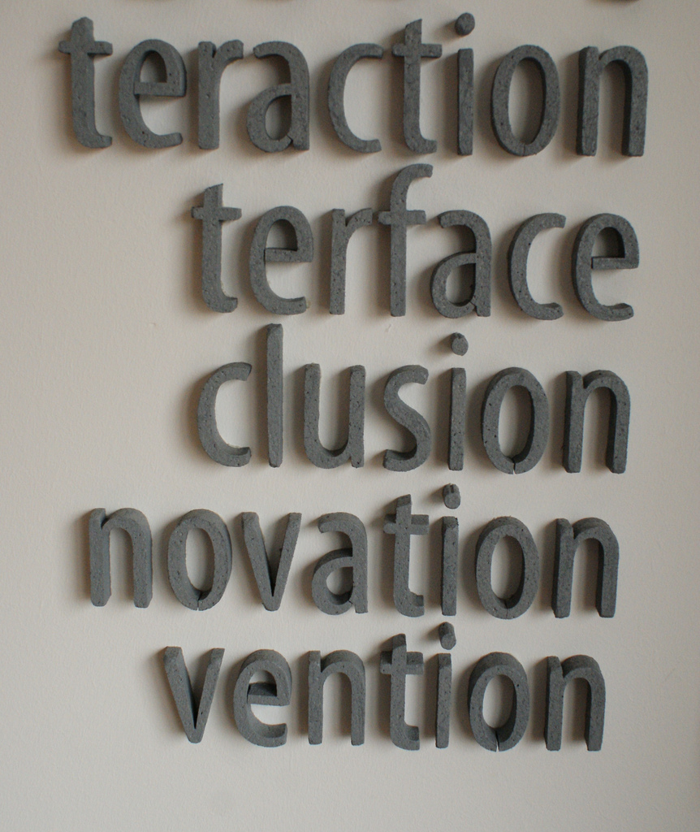
lucamascaro

Slide 6
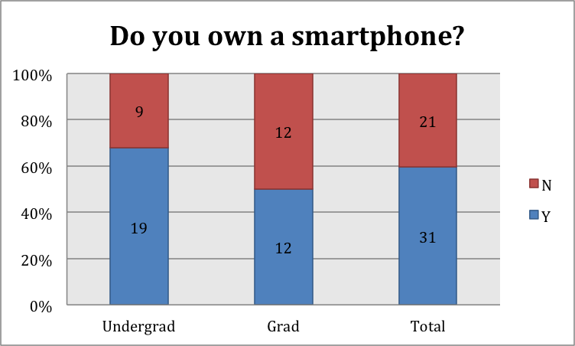
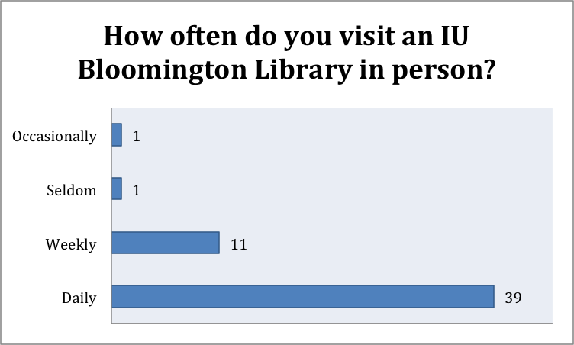
needs assessment
Surveyed 52 students about use of libraries, library site, smartphones. Most frequently used sites? Facebook, Google, & IU e-mail; also OnCourse (campus LMS) & OneStart (campus portal). Most heavily used services on the Library site were also the most requested additions to mobile site: IUCat (library catalog) & databases.

Slide 7
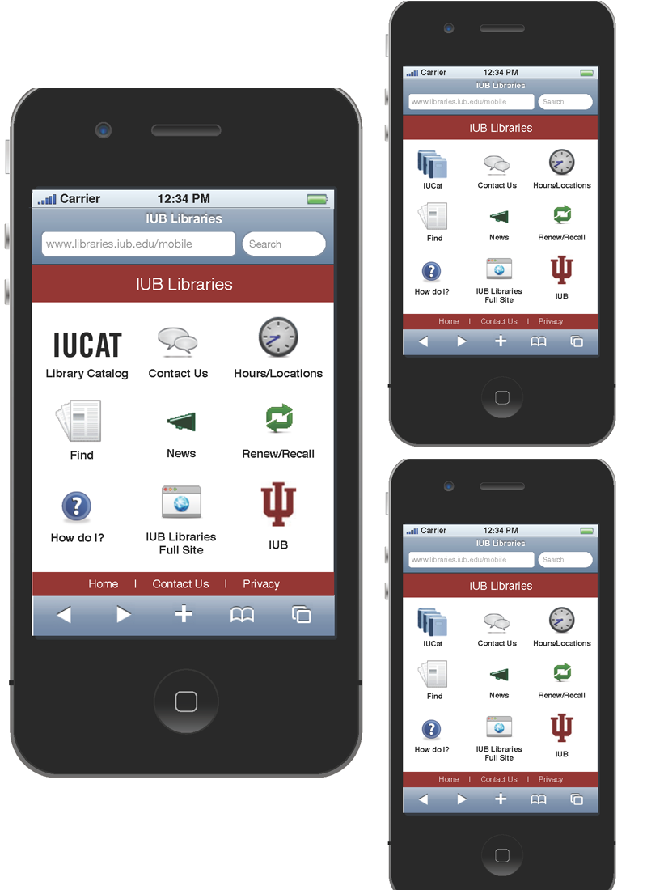
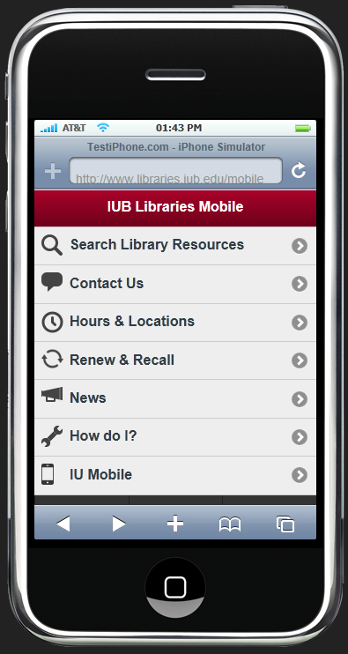
prototyping
Touch screens – new tools, new ways. Used paper prototypes + new system for logging user paths.
Tools used: Omnigraffle, iPhone stencils

Slide 8
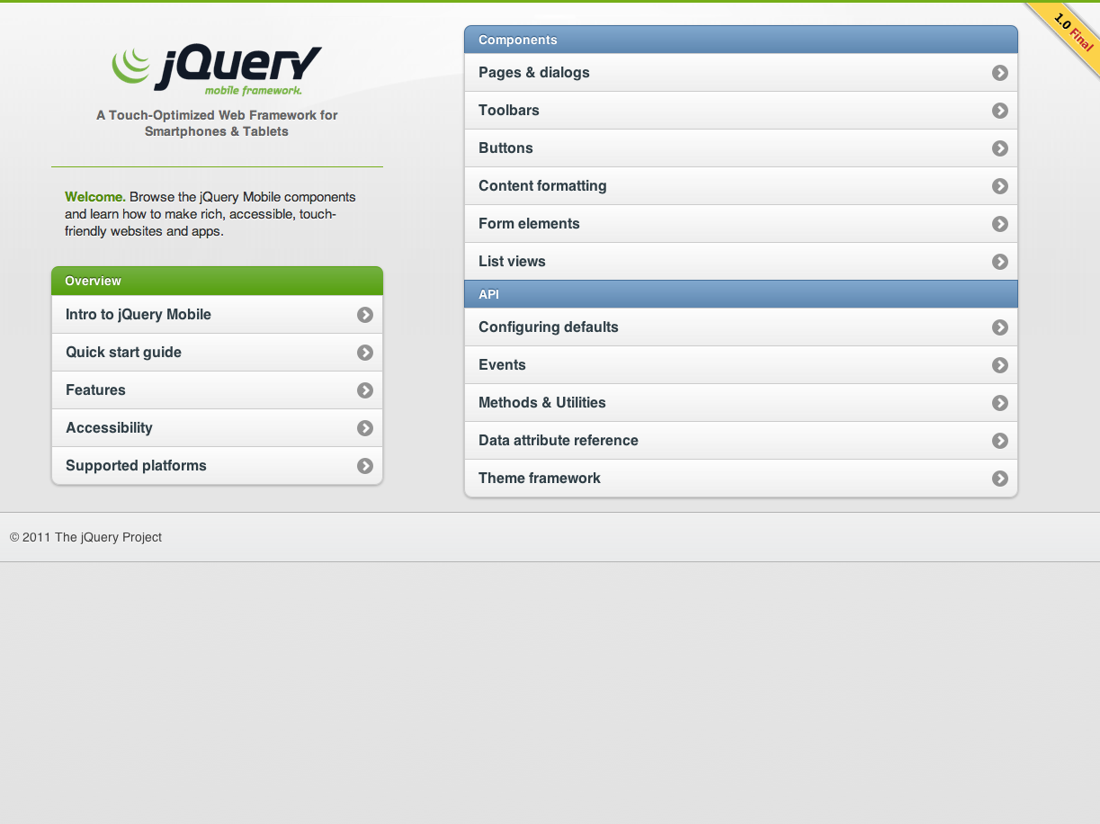
jquerymobile.com
extends jQuery
uniform UX
theme roller
framework

Slide 9
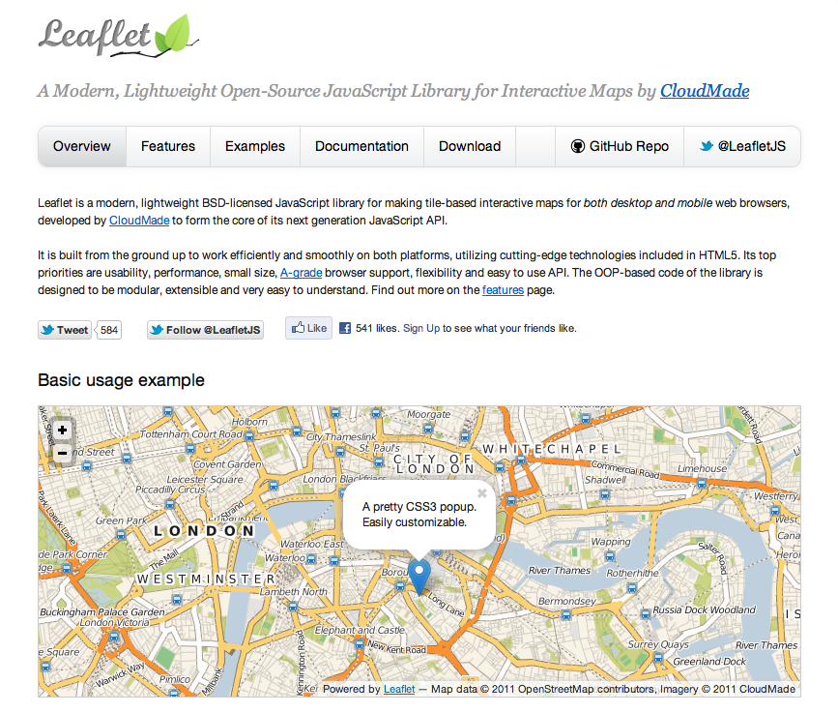
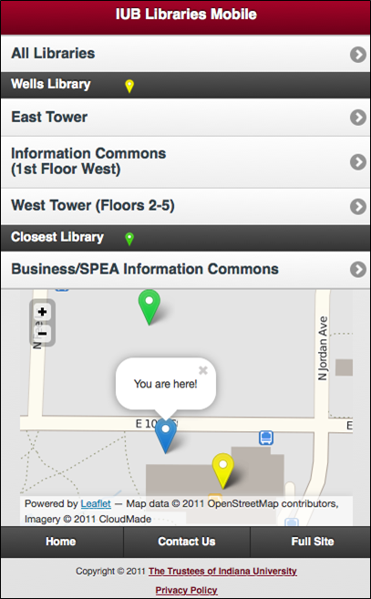
geolocation
leaflet.cloudmade.com
lightweight
cross browser
well documented
extensible

Slide 10

prepare yourselves.
we’re going to show some code.
pink sherbet

Slide 12
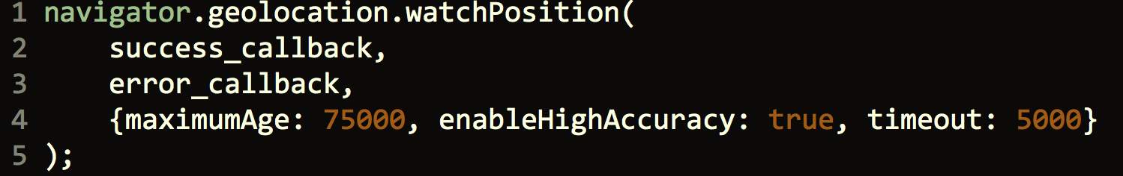

Slide 13
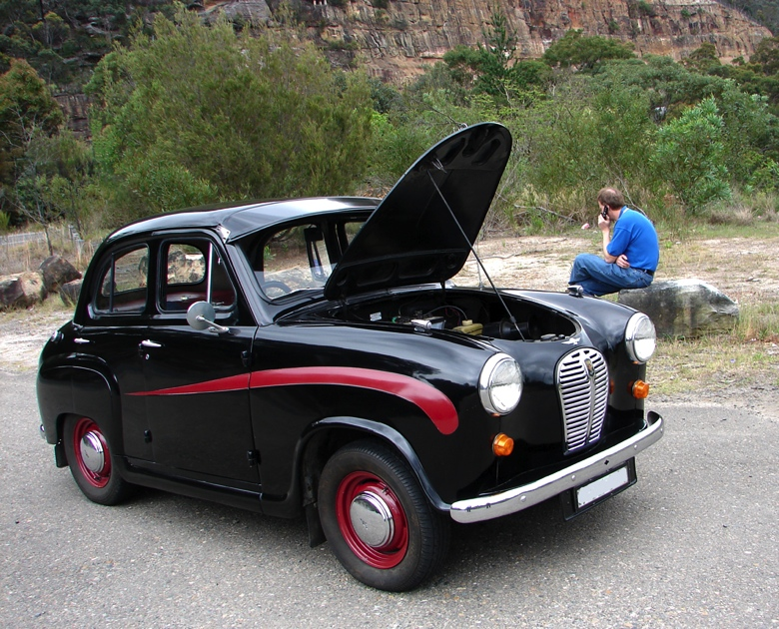
aussiegall

Slide 14
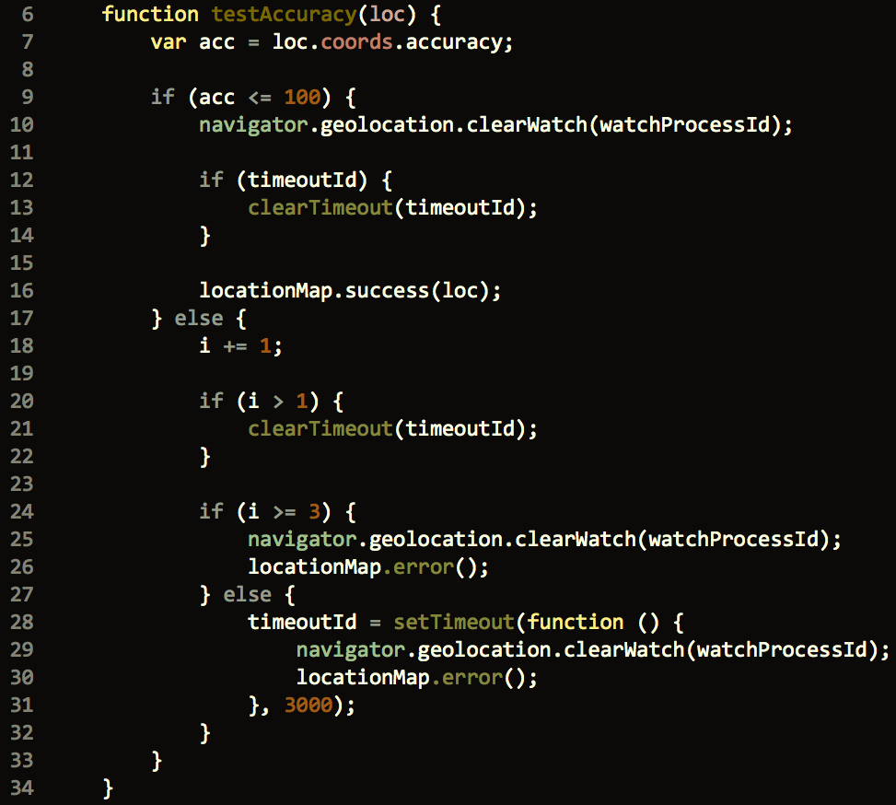

Slide 15
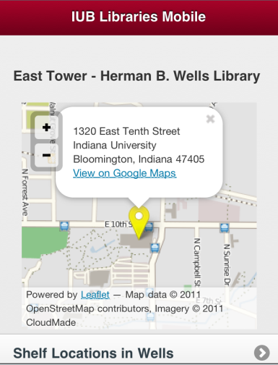
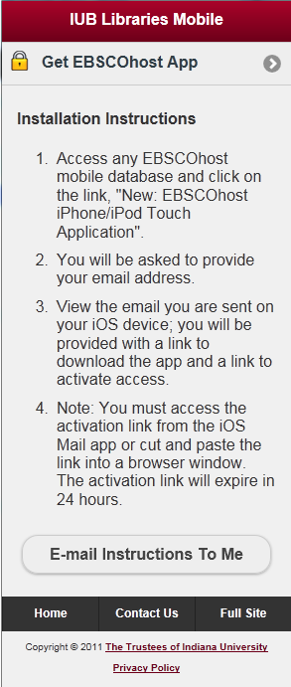
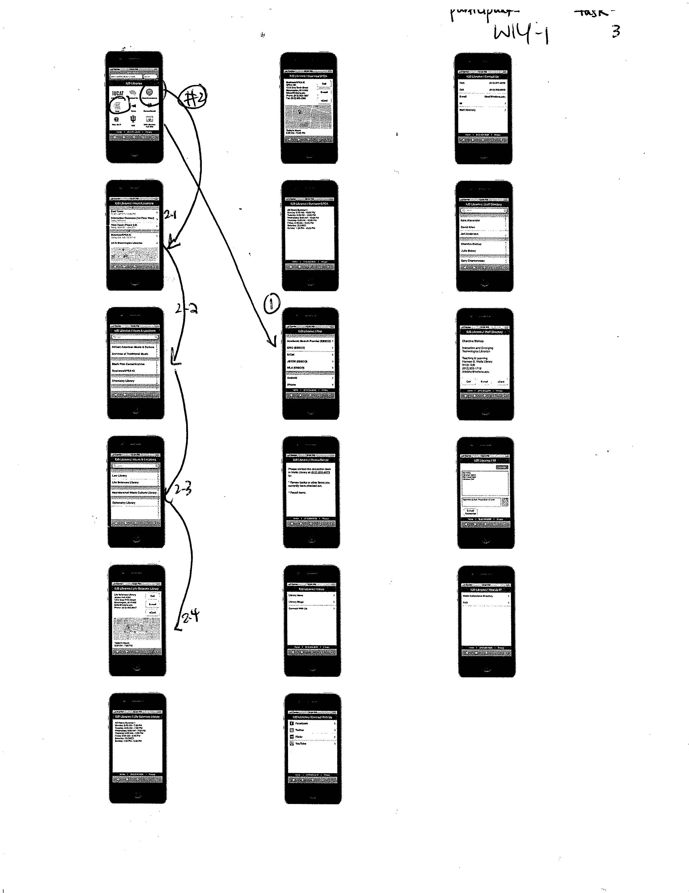
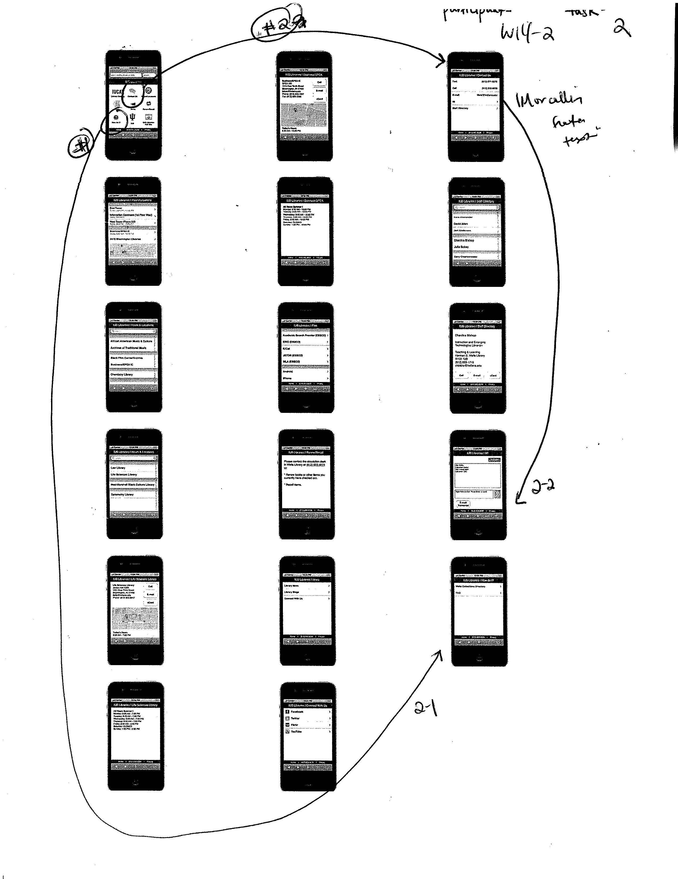
testing
Development: conducted five tests with paper prototype, focused on labels, site structure, icons. Resulted in a total shift in approach.
Informal feedback: candy bars & surveys at Welcome Week event.
Live site: six tests, focused on mapping function, information architecture, and labeling.

Slide 16
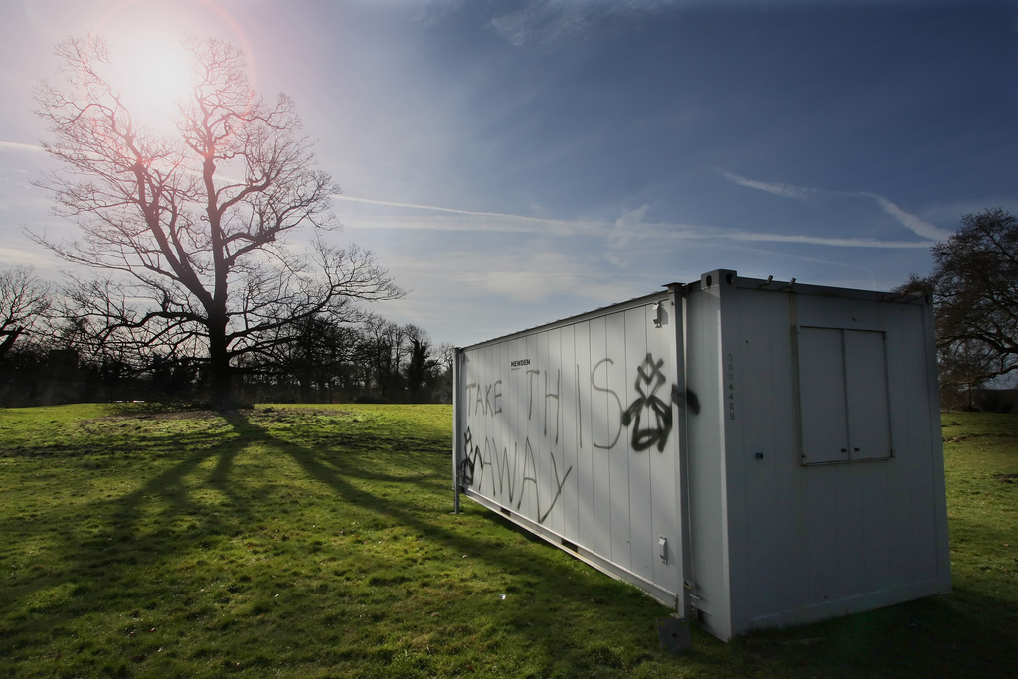
takeaways
leo reynolds

Slide 17
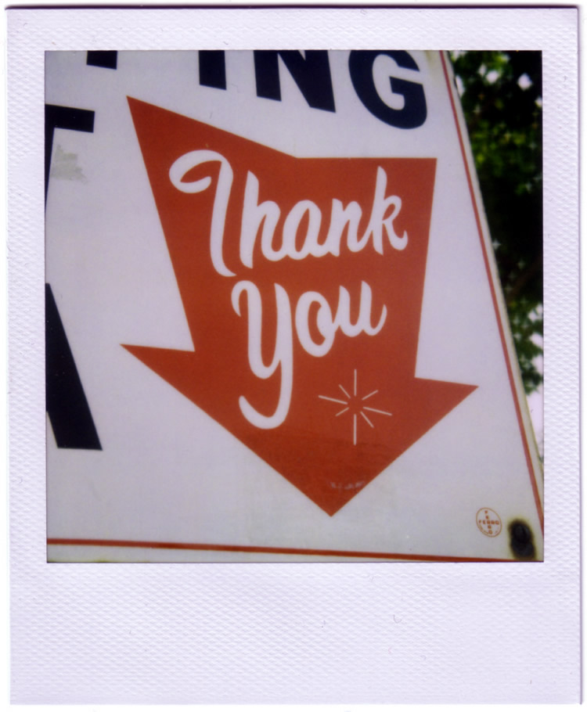
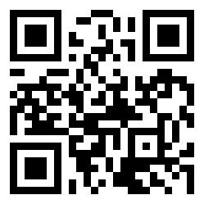
slides + more: http://bit.ly/hhl6-ux
Courtney Greene Indiana University Libraries crgreene at indiana dot edu
Bret Davidson NCSU Libraries Fellow (as of 2.6 ☺) bretdavidson at gmail
rustman

